Slide 1

Understanding Smartphone Addiction
PhoneSense: Smartphone Addiction Prediction
Presented by Kirtan Sukhadiya, Abhijeet Singh

Slide 2

PhoneSense Overview
Understanding PhoneSense and Its Purpose
PhoneSense utilizes machine learning to predict addiction risk by analyzing user behavior and survey data, aiming to assist researchers and advocates in addressing smartphone dependency effectively.
Null Hypothesis
Daily smartphone usage hours, phone checks per day, time spent on social media, anxiety level, depression level, sleep hours, and exercise hours do not collectively predict smartphone addiction level.
Demo
PhoneSense.app
2

Slide 3
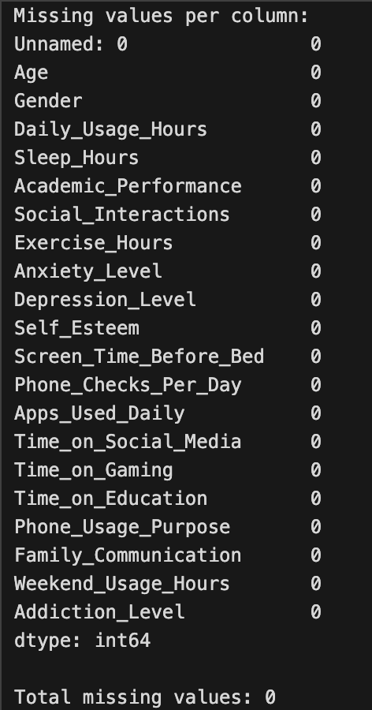
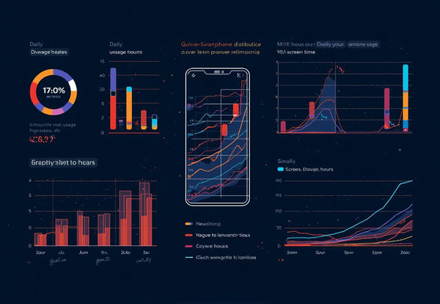
Cleaned Dataset Overview
3

Slide 4
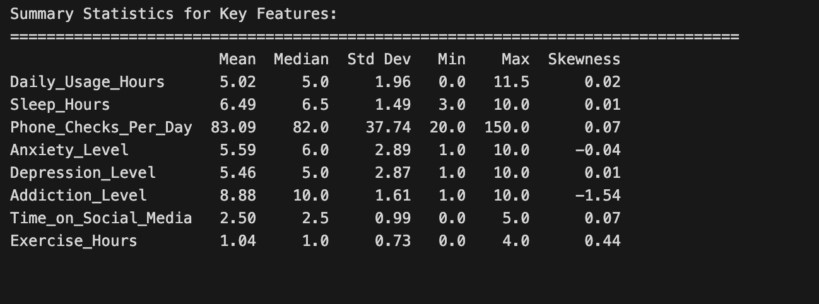
Summary Statistics for Key Features:
4

Slide 5
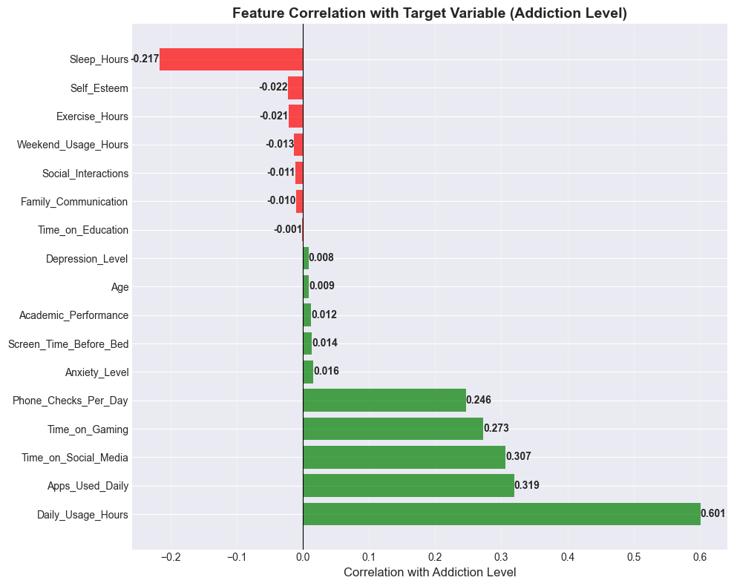
Feature Correlation with Target Variable (Addiction Level)
5

Slide 6
Methodology Overview
Data Loading
Preprocessing
Model Training
Data is sourced and loaded into the analysis environment.
Initial data is cleaned and structured for further analysis.
Various models are trained and evaluated for performance.
6

Slide 7
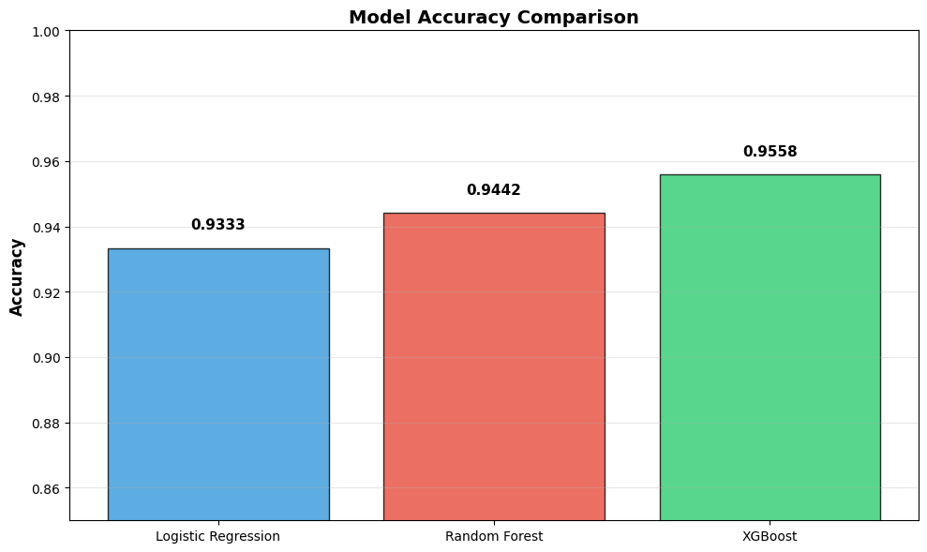
Models Used
Logistic Regression
This model predicts addiction based on linear relationships
We are using overSampling..
Random Forest
An ensemble approach improving accuracy through aggregated predictions.
XGBoost
Boosting technique optimizing performance for complex data patterns.
7

Slide 8
93%
94%
96%
Logistic Regression
Random Forest
XGboost
8

Slide 9
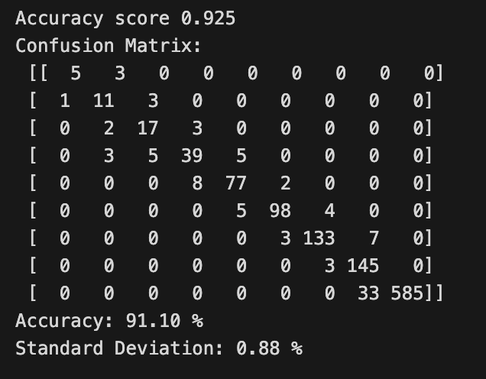
Evaluating Accuracy
93%
Logistic Regression
9

Slide 10
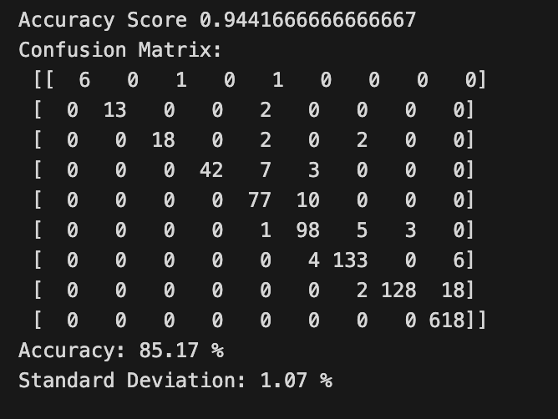
Evaluating Accuracy
94%
Random Forest
10

Slide 11
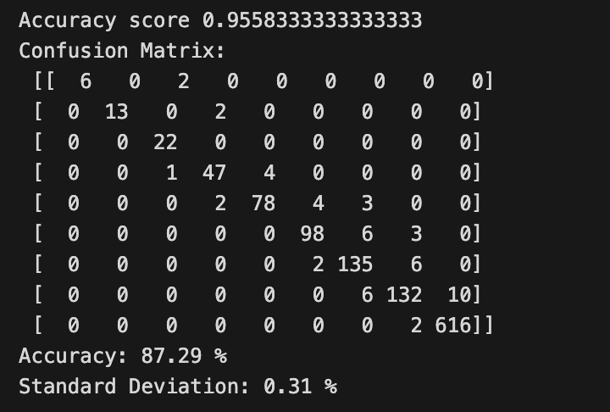
Evaluating Accuracy
96%
XGboost
11

Slide 12
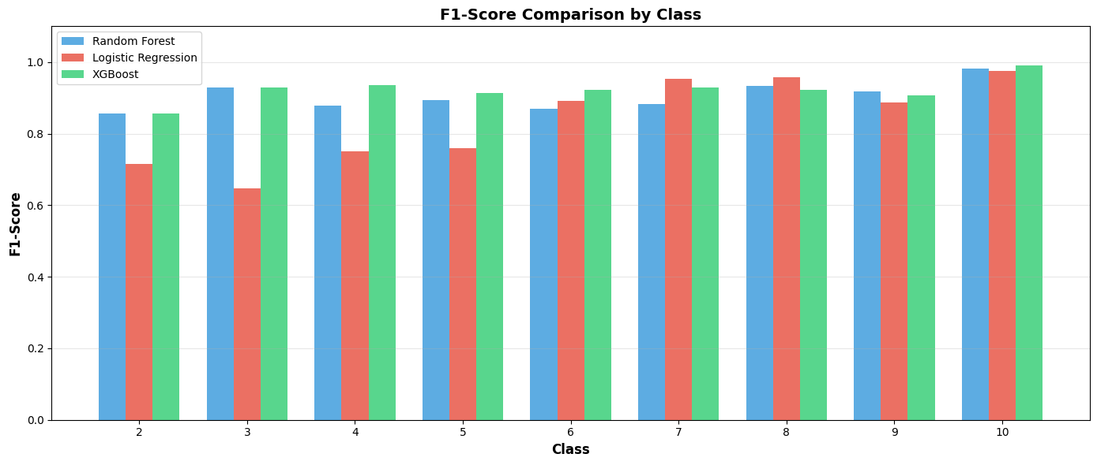
F1 Score
12

Slide 13
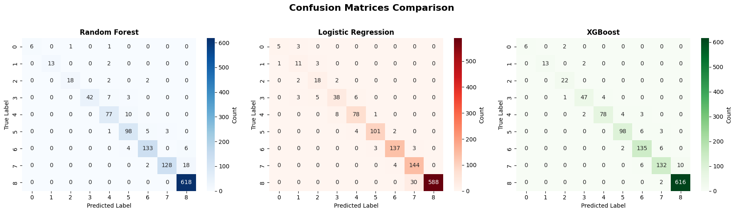
Heatmap
13

Slide 14

Theoretical Framework
Exploring behavioral patterns in smartphone usage
14

Slide 15
Age Moderation
Understanding the Relationship Dynamics
Age Moderates Usage
The hypothesis suggests that younger users exhibit a stronger relationship between daily smartphone usage and addiction levels, while older users show a comparatively weaker association, highlighting age's moderating effect.
15

Slide 16
Age Moderation Effects
Understanding how age influences smartphone addiction risk dynamics
This visualization illustrates the relationship between daily usage and addiction level, highlighting age as a critical moderating factor in the analysis.
16

Slide 17
Conclusion
Impact of PhoneSense on Digital Wellness
In summary, PhoneSense serves as a valuable tool for evaluating smartphone addiction risk through machine learning techniques. By leveraging behavioral and survey data, it identifies individuals at varying levels of risk, providing insights that can inform targeted interventions.
Key takeaways include:
  Addressing the rising dependency on smartphones
  Understanding age as a critical moderating factor
  Promoting digital wellness through data-driven approaches
The potential impact extends beyond individual assessments, influencing broader digital wellness initiatives. PhoneSense can facilitate awareness campaigns, assist developers in creating healthier digital environments, and support researchers in understanding the dynamics of smartphone addiction.
This project underscores the importance of a proactive approach to mental health in our increasingly digital world.
17

